Slide 1
Online Optimization of Power Networks
Steven Low
March 2016
CISS Plenary Princeton
Notes:
May 2012: Santa Fe Institute Workshop on Smart Grid, Santa Fe, NM
July 2012: Network Science Workshop, Chinese University of Hong Kong, HK (Raymond Yeung)
Sept 2012: Melbourne University, EEE Department (Pascal van Hentenryck)
February 13, 2013: ITA Workshop, San Diego
May 20, 2013: IEEE Workshop on Modeling and Simulation of Cyber-Physical Energy Systems, Berkeley, CA (Peter Palensky, Edward A. Lee)
Oct 31, 2013: Google, Mountain View, CA (Arun Mazumdar)
Nov 5, 2013: Asilomar Conference, invited session on Power Networks (Edmund Yeh)
Nov 15, 2013: NSF Workshop on Smart Grid, Washington DC (Giannakis, Sairaj, SL)
Dec 2, 2013: UCLA EE (Mani Srivastava)
Dec 5, 2013: Keynote, GlobalSIP (Global Conf on Signal & Info Processing) Symposium on Signal Processing in Smart Grid (Shalinee Kishore, Lalitha Sankar)
Jan 16, 2014: Stanford Smart Grid seminar (Ram Rajagopal, Baosen Zhang)
Feb 4, 2014: 9th Annual CARNEGIE MELLON CONFERENCE ON THE ELECTRICITY INDUSTRY, (Marija Ilic, Krishnan Kant)
May 22, 2014: UC Berkeley (Kameshwar)
Oct 3, 2014: ASU (Junshan Zhang)
Nov 3, 2014: Asilomar Conference, invited session on Smart Grid: learning and optimization, Pacific Grove, CA
Nov 10, 2014: EE Control Group, Berkeley (Claire Tomlin)
Jan 16, 2015, Grid Science Winter School and Conference (Scott Backhaus, Misha Chertkov)
June 9, 2015: Advanced Mathematical Methods For Energy Systems: from Theory to Practice, Moscow, Russia (Janusz Bialek, Skoltech)
July 7, 2015, Tsinghua power systems group (Prof Song Yonghua)
July 21, 2015: Hong Kong University, EEE (David Hill, Victor Li)
Online algorithms for power systems
============================
Jan 14, 2016: IPAM Workshop on Optimization and Equilibrium of Energy Economics, UCLA, CA (Mike Ferris)
Jan 28, 2016: ESIF Workshop on Frontiers in Distributed Optimization and Control of Sustainable Power Systems, NREL, Golden, CO (Emiliano Dall’Anese, Brian Johnson)
Feb 8, 2016: PNNL (Jakob Stoustrup)
Feb 10, 2016: Georgia Tech, School of Industrial & Systems Engineering (Andy Sun)
March 10, 2016: Caltech CMI Faculty talk (Michelle Effros)
March 17, 2016: CISS Plenary talk, Princeton, NJ (Mung Chiang)

Slide 2
Key message
Large network of DERs
Real-time optimization at scale
Computational challenge: power flow solution
Online optimization [feedback control]
Network computes power flow solutions in real time at scale for free
Exploit it for our optimization/control
Naturally adapts to evolving network conditions
Examples
Slow timescale: OPF
Fast timescale: frequency control

Slide 3
Outline
Background: smart grid
Online OPF
Optimal power flow & relaxations
Online algorithm
Analysis and simulations
Load-side frequency control
Dynamic model & design approach
Distributed online algorithm
Analysis and simulations
Gan & L, JSAC 2016
Zhao, Topcu, Li, L, TAC 2014
Mallada, Zhao, L, Allerton 2014
Zhao et al: CDC 2014, CISS 2015, PSCC 2016

Slide 4
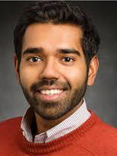


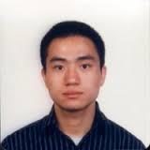
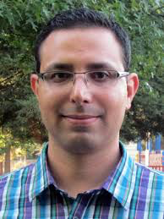
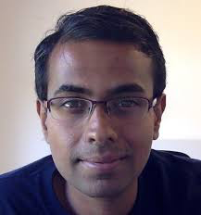
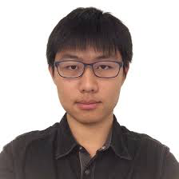
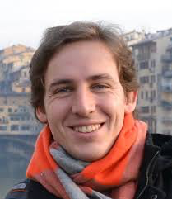
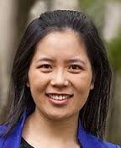
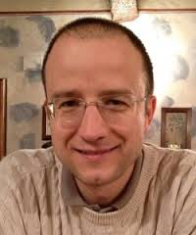
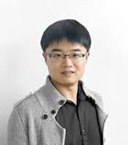
Semidefinite
relaxations
of OPF
Bose (UIUC)
Chandy
Farivar
Gan (FB)
Lavaei (UCB)
Online OPF
Gan (FB)
Dvijotham
Tang
Dynamics
Mallada (JHU)
Li (Harvard)
Topcu (Austin)
Zhao

Slide 5
Watershed moment
Power network will undergo similar architectural
transformation that phone network went through
in the last two decades
Deregulation
started
Tesla: multi-phase AC
IoT
1888
Both started as natural monopolies
Both provided a single commodity
Both grew rapidly through two WWs
1980-90s
1876
1980-90s
Internet
Bell: telephone
Deregulation
started
1969:
DARPAnet

Slide 6
Four drivers
Proliferation of renewables
Electrification of transportation
challenges
Advances in power electronics
Deployment of sensing, control, comm
enablers

Slide 7

Area to power the world by solar
Notes:
World wind speed at 100m:
All wind worldwide: 1,700 TW
All wind over land in high-wind areas outside Antartica: 70 – 170 TW
World power (all energy) demand in 2030: 16.9 TW
World surface solar
All solar worldwide: 6,500 TW
All solar over land in high-solar locations: 340 TW
Source: Renewable Energy Global Status Report, Sept 2010:
2009 grid-tied solar PV capacity increase
The world added 7GW of grid-connected PV capacity, to a total of 21 GW
Germany: +3.8 GW to a total of 9.8 GW
Spain: +70MW to a total of 3.4 GW (Govt subsidy expired!)
US: +470MW to a total of 1 GW (CA ~half of increase)
Off-grid capacity: 4 GW
2009 wind capacity increase
Wind power increased the most among all renewables, by 38 GW to a total of 159 GW
US: +10 GW to a total of 35 GW
China: +13.8 GW to a total of 25.8 GW
Germany: +1.9GW to a total of 25.8 GW

Slide 8
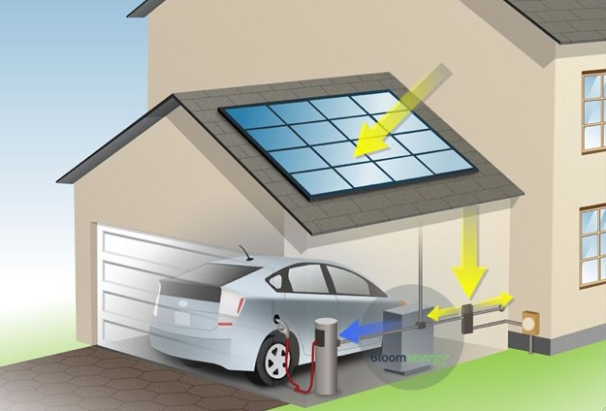
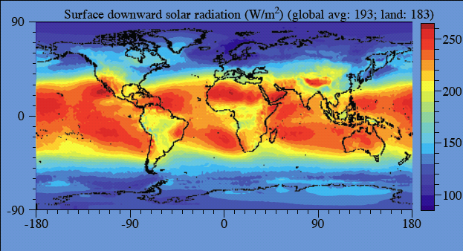

Solar power over land:
> 20x world energy demand
network of
billions of active distributed energy resources (DERs)
DER: PV, wind tb, EV, storage, smart bldg / appl

Slide 9

ligence
everywhere
connected

Slide 10

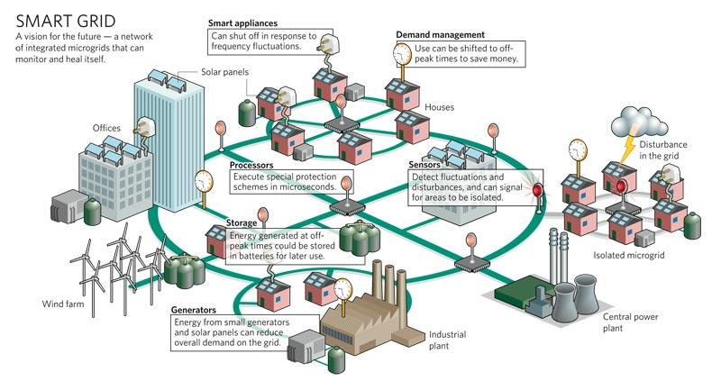
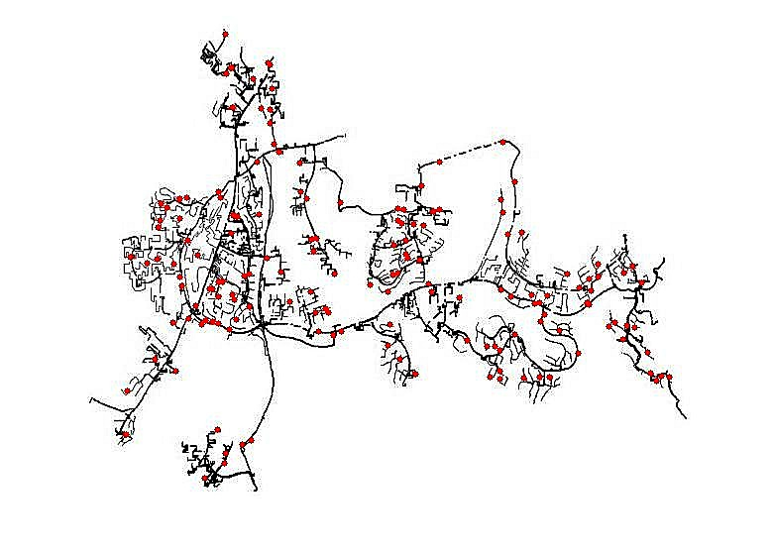
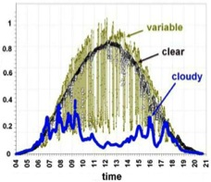








Risk: active DERs introduce rapid random
fluctuations in supply, demand, power quality
increasing risk of blackouts
Opportunity: active DERs enables realtime
dynamic network-wide feedback control,
improving robustness, security, efficiency
Caltech research: distributed control of networked DERs
Foundational theory, practical algorithms, concrete
applications
Integrate engineering and economics
Active collaboration with industry

Slide 11
Recap
Global energy demand will continue to grow
Traditional supply is unsustainable
There is more renewable energy than the world ever needs
Someone will figure out how to capture and store it
There will be connected intelligence everywhere
Cost of computing, storage, communication and manufacturing will continue to drop
Power system will transform into the largest and most complex Internet of Things
Generation, transmission, distribution, consumption, storage

Slide 12
Recap
To develop technologies that will enable and guide the historic transformation of our power system
Generation, transmission, distribution, consumption, storage
Devices, systems, theory, algorithms
Control, optimization, stochastics, data, economics

Slide 13
Outline
Background: smart grid
Online OPF
Optimal power flow & relaxations
Online algorithm
Analysis and simulations
Load-side frequency control
Dynamic model & design approach
Distributed online algorithm
Analysis and simulations
Gan & L, JSAC 2016
Zhao, Topcu, Li, L, TAC 2014
Mallada, Zhao, L, Allerton 2014
Zhao et al: CDC 2014, CISS 2015, PSCC 2016

Slide 14
Optimal power flow (OPF)
OPF is solved routinely for
network control & optimization decisions
market operations & pricing
at timescales of mins, hours, days, …
Non-convex and hard to solve
Huge literature since 1962
Common practice: DC power flow (LP)
Also: Newton-Raphson, interior point, …

Slide 15
Optimal power flow (OPF)
OPF underlies many applications
Unit commitment, economic dispatch
State estimation
Contingency analysis
Feeder reconfiguration, topology control
Placement and sizing of capacitors, storage
Volt/var control in distribution systems
Demand response, load control
Electric vehicle charging
Market power analysis
…

Slide 16
Bus injection model
Power flow equations
OPF = QCQP ➔ SDP relaxation

Slide 17
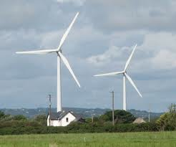

Branch flow model
j
k
directed graph G

Slide 18
Branch flow model
Branch flow model
power balance
“Ohm’s law”
def of power

Slide 19
Branch flow model
Branch flow model
linear
quadratic
DistFlow equations (radial nk)
Baran & Wu, 1989

Slide 20
Branch flow model
Bus injection model
Branch flow model
DistFlow equations (radial nk)
Baran & Wu, 1989

Slide 21
Branch flow model
Bus injection model
Branch flow model
+ cycle condition on

Slide 22
Cycle condition
A relaxed solution satisfies the cycle condition if
incidence matrix;
depends on topology

Slide 23
Branch flow model
Bus injection model
Branch flow model
+ cycle condition on
Theorem: BIM = BFM
[Farivar & Low 2013 TPS
Bose et al 2012 Allerton]

Slide 24
Branch flow model
BFM and BIM are equivalent (nonlinear bijection)
… but some results are easier to formulate or
prove in one than the other
BFM is much more numerically stable
BFM is useful for radial networks
Extremely efficient computation (BFS)
Much better linearization
Compact extension to multiphase unbalanced nk
Gan & L PSCC 2014

Slide 25
Branch flow model
Branch flow model
+ cycle condition on

Slide 26
SOCP relaxation
Branch flow model

Slide 27
Optimal power flow (OPF)
nonconvex

Slide 28
Optimal power flow (OPF)
nonconvex

Slide 29
SOCP relaxation of OPF

Slide 30
Sufficient conds for exact relaxation
For mesh networks, see recent works of Andy Sun, Pascal van Hentenryck on
relaxation of cycle condition
Tutorial: Convex relaxation of OPF, IEEE Trans. Control of Network Systems, 2014

Slide 31
Sufficient conds for exact relaxation
For mesh networks, see recent works of Andy Sun, Pascal van Hentenryck on
relaxation of cycle condition
Tutorial: Convex relaxation of OPF, IEEE Trans. Control of Network Systems, 2014

Slide 32
SOCP relaxation of OPF
Theorem: SOCO is exact for tree networks if
Not both real & reactive power are both lower & upper bounded at each end of a line; or
Voltage upper bounds are not tight
[Farivar et al 2013, Gan et al 2014, Bose et al 2015]

Slide 33
Convex relaxations of OPF
Kim, Baldick 1997
Dall’Anese et al 2012
Lam et al 2012
Kraning et al 2013
Devane, Lestas 2013
Sun et al 2013
Li et al 2013
Peng, Low 2014
applications
Phan 2012
Gopalakrishnan 2012
Louca et al 2013
Hijazi et al 2013
B&B,
rank min,
QC relaxation,
distributed
OPF
semidefinite relaxations
multiphase
unbalanced
exactness
moment/SoS,
based
relaxation
Dall’Anese et al 2012
Gan, Low 2014
ext refs in Low
TCNS 2014
Louca et al 2014
Molzahn, Hiskens 2014
Josz et al 2014
Ghaddar et al 2014

Slide 34
SOCP relaxation of OPF
But all these algorithms are offline …
… unsuitable for real-time optimization of
network of distributed energy resources

Slide 35
SOCP relaxation of OPF
We will compare our online algorithm to
SOCP relaxation wrt optimality and speed

Slide 36
Outline
Background: smart grid
Online OPF
Optimal power flow & relaxations
Online algorithm
Analysis and simulations
Load-side frequency control
Dynamic model & design approach
Distributed online algorithm
Analysis and simulations
Gan & L, JSAC 2016

Slide 37
OPF
controllable devices
F(x, y) = 0
BFM
uncontrollable state

Slide 38
OPF
power flow equations
operational constraints
capacity limits

Slide 39
OPF
power flow equations
operational constraints
capacity limits

Slide 40
OPF
power flow equations
operational constraints
capacity limits

Slide 41
OPF
controllable devices
F(x, y) = 0
power flow equations
operational constraints
(on y)
capacity limits (on x)

Slide 42
OPF: eliminate y

Slide 43
OPF: add barrier
add barrier function
to remove
operational constraints
L: nonconvex

Slide 44
Online (feedback) perspective
measurement,
communication
y(t)
control
x(t)
Gan & Low JSAC 2016
Dall’Anese & Simonetto 2016

Slide 45
Online gradient algorithm
gradient projection algorithm:
active control
law of physics
Explicitly exploits network as power flow solver
Naturally tracks changing network conditions

Slide 46
Online gradient algorithm
gradient projection algorithm:
active control
law of physics
Results
Local optimality
Global optimality
Suboptimality bound
Tracking performance
Gan & L, JSAC 2016
Dvijotham, Tang & L, 2016

Slide 47
Local optimality
x(t) converges to set of local optima
if #local optima is finite, x(t) converges

Slide 48
Global optimality
Theorem
If co{local optima} are in A then
x(t) converges to the set of global optima
x(t) itself converges a global optimum if #local optima is finite

Slide 49
Global optimality
Theorem
If SOCP is exact over X, then assumption holds

Slide 50
Suboptimality gap
any original
feasible pt
slightly away
from X boundary
any local
optimum
Informally, a local minimum is almost as good
as any strictly interior feasible point

Slide 51
Tracking performance
drifting
OPF

Slide 52
Tracking performance
cost of Alg
dynamic
regret
optimal cost
Theorem
rate of
drifting
subopt of
local min

Slide 53
Tracking performance
cost of Alg
dynamic
regret
optimal cost
Theorem
rate of
drifting
subopt of
local min

Slide 54
Tracking performance
cost of Alg
dynamic
regret
optimal cost
Theorem
If rate of drifting is then per-step
is asymptotically bounded by
Can made arbitrarily small at cost of computation
(local min)

Slide 55
Simulations

Slide 56
Key message
Large network of DERs
Real-time optimization at scale
Computational challenge: power flow solution
Online optimization
Network computes power flow solutions in real time at scale for free
Exploit it for our optimization/control
Naturally adapts to evolving network conditions
Examples
Slow timescale: OPF
Fast timescale: frequency control

Slide 57
Outline
Optimal power flow
Background: semidefinite relaxations
Online algorithm
Analysis and simulations
Load-side frequency control
Dynamic model & design approach
Distributed online algorithm
Analysis and simulations
Zhao, Topcu, Li, L, TAC 2014
Mallada, Zhao, L, Allerton 2014
Zhao et al: CDC 2014, CISS 2015, PSCC 2016

Slide 58
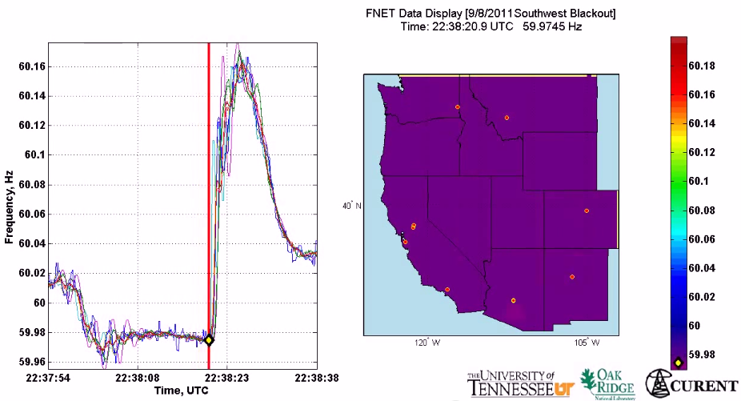
Motivation
All buses synchronized to same nominal frequency (US: 60 Hz; Europe/China: 50 Hz)
Supply-demand imbalance ➔ frequency fluctuation
(1 min)
2011 Southwest blackout

Slide 59
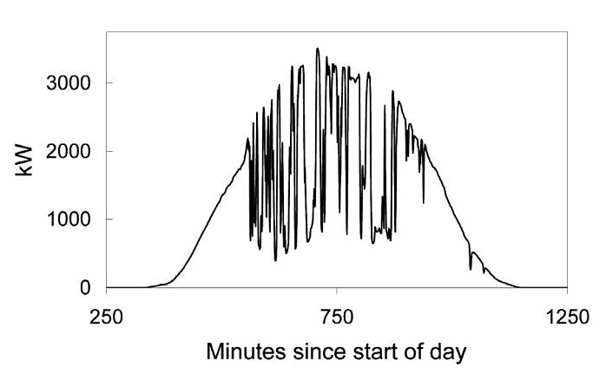
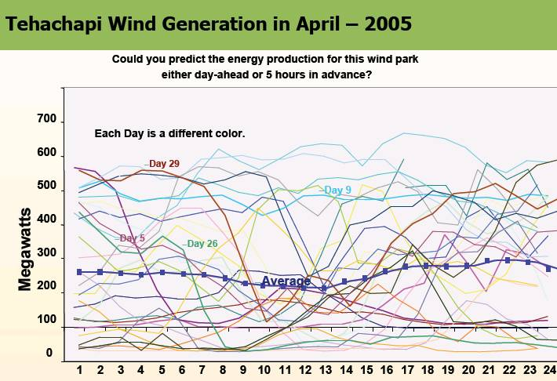
Motivation
Imagine when we have 50%+ renewable generation …
(10 min)
(1 min)

Slide 60
Why load-side participation
Ubiquitous continuous load-side control can supplement generator-side control
faster (no/low inertia)
more reliable (large #)
better localize disturbances
reducing generator-side control capacity
secondary freq control
economic
dispatch
primary
freq control
sec
min
5 min
60 min

Slide 61
What is the potential
Residential load accounts
for ~1/3 of peak demand
61% residential appliances
are Grid Friendly
US:
operating reserve: 13% of peak
total GFA capacity: 18%
Lu & Hammerstrom (2006), PNNL

Slide 62
How
How to design load-side frequency control ?
How does it interact with generator-side control ?

Slide 63
Literature: load-side control
Original idea & early analytical work
Schweppe et al 1980; Bergin, Hill, Qu, Dorsey, Wang, Varaiya …
Small scale trials around the world
D.Hammerstrom et al 2007, UK Market Transform Programme 2008
Early simulation studies
Trudnowski et al 2006, Lu and Hammerstrom 2006, Short et al 2007, Donnelly et al 2010, Brooks et al 2010, Callaway and I. A. Hiskens, 2011, Molina-Garcia et al 2011
Analytical work – load-side control
Zhao et al (2012/2014), Mallada and Low (2014), Mallada et al (2014), Zhao and Low (2014), Zhao et al (2015)
Simpson-Porco et al 2013, You and Chen 2014, Zhang and Papachristodoulou (2014), Ma et al (2014), Zhao, et al (2014),
Recent analysis – generator-side/microgrid control:
Andreasson et al (2013), Zhang and Papachristodoulou (2013), Li et al (2014), Burger et al (2014), You and Chen (2014), Simpson-Porco et al (2013), Hill et al (2014), Dorfler et al (2014)

Slide 64
Network model
branch power
generator or load
loads:
damping or uncontrollable
i : region/control area/balancing authority

Slide 65
Network model
Generator bus: M_{i} > 0
Load bus: M_{i} = 0

Slide 66
Network model
Generator bus: p_{i} is real power injection
Load bus: p_{i} is controllable load

Slide 67
Generator-side control
generator bus:

Slide 68
Load-side control
Load bus:
how to design feedback control ?

Slide 69
Network model
Suppose the system is in steady state
Then: disturbance in gen/load …

Slide 70
Load-side controller design
Control goals (while min disutility)
Rebalance power & stabilize frequency
Restore nominal frequency
Restore scheduled inter-area flows
Respect line limits
Zhao, Topcu, Li, Low
TAC 2014
Mallada, Zhao, Low
Allerton, 2014

Slide 71
Load-side controller design
Control goals (while min disutility)
Rebalance power & stabilize frequency
Restore nominal frequency
Restore scheduled inter-area flows
Respect line limits
Zhao, Topcu, Li, Low
TAC 2014
Mallada, Zhao, Low
Allerton, 2014

Slide 72
Load-side controller design
Design control law
whose equilibrium
solves:
load disutility
power balance
inter-area flows
line limits
Control goals (while min disutility)
Rebalance power & stabilize frequency
Restore nominal frequency
Restore scheduled inter-area flows
Respect line limits
freq will emerge as
Lagrange multiplier
for power imbalance

Slide 73
Load-side controller design
Design control (G, F) s.t. closed-loop system
is stable
has equilibrium that is optimal
power network
load control

Slide 74
Load-side controller design
Idea: exploit system dynamic as part of primal-dual algorithm for modified opt
Distributed algorithm
Stability analysis
Control goals in equilibrium
power network
load control

Slide 75
Summary: control architecture
physical network
Primary load-side frequency control
completely decentralized
Theorem: stable dynamic, optimal equilibrium
Zhao, Topcu, Li, Low. TAC 2014

Slide 76
Summary: control architecture
physical network
cyber network
Secondary load-side frequency control
communication with neighbors
Theorem: stable dynamic, optimal equilibrium
Mallada, Zhao, Low. Allerton 2014

Slide 77
Summary: control architecture
physical network
cyber network
With generator-side control, nonlinear power flow
load-side improves both transient & eq
Theorem: stable dynamic, optimal equilibrium
Zhao, Mallada, Low. CISS 2015

Slide 78
Local frequencies
[Tom Overbye, 2015 Cornell]

Slide 79
Simulations
Dynamic simulation of IEEE 39-bus system
Power System Toolbox (RPI)
Detailed generation model
Exciter model, power system
stabilizer model
Nonzero resistance lines

Slide 80
Primary control

Slide 81
Secondary control
swing dynamics
with OLC
area 1

Slide 82
Secondary control
line limit
no line limits
Total inter-area flow is
the same in both cases
line limit
with line limits

Slide 83
Key message
Large network of DERs
Real-time optimization at scale
Computational challenge: power flow solution
Online optimization
Network computes power flow solutions in real time at scale for free
Exploit it for our optimization/control
Naturally adapts to evolving network conditions
Examples
Slow timescale: OPF
Fast timescale: frequency control

Slide 84
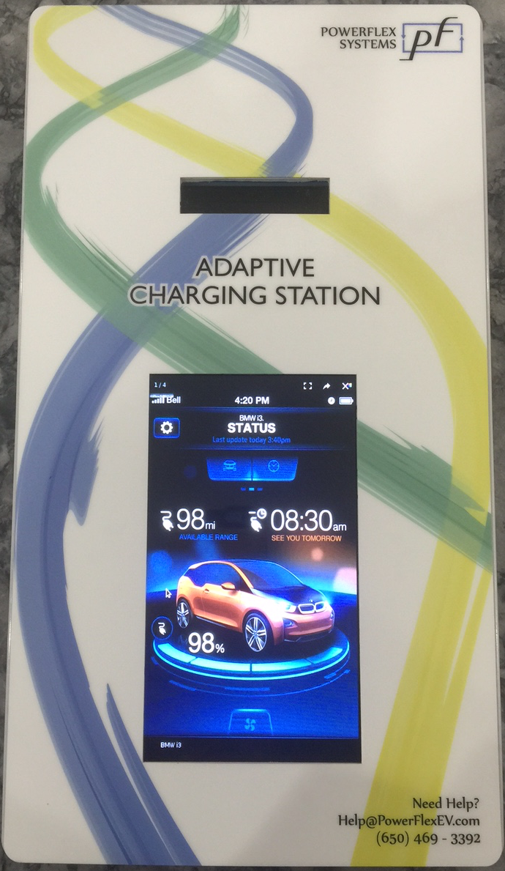
Application: EV charging
Online optimization of electric vehicle charging
Enables mass deployment at much lower infrastructure costs
First pilot @Caltech: 54 adaptive programmable chargers
2x 150kVA transformers, breakers, grid sensors, etc
debugging
Energized
Feb 13 Sat
2016
charger
150kVA transformer
main panel
G. Lee

Slide 85
more details
(backup)

Slide 86
Recall: design approach
Idea: exploit system dynamic as part of primal-dual algorithm for modified opt
closed-loop system is stable
its equilibria are optimal
power network
load control

Slide 87
Outline
Load-side frequency control
Primary control
Secondary control
Interaction with generator-side control
Zhao et al SGC2012, Zhao et al TAC2014

Slide 88
Optimal load control (OLC)
demand = supply
disturbances
controllable
loads

Slide 89
system dynamics + load control = primal dual alg
swing dynamics
implicit
load control
active control

Slide 90
Control architecture

Slide 91
Load-side primary control works
Theorem
Starting from any
system trajectory
converges to
is unique optimal of OLC
is unique optimal for dual
completely decentralized
frequency deviations contain right info for local decisions that are globally optimal

Slide 92
Recap: control goals
Rebalance power
Stabilize frequencies
Restore nominal frequency
Restore scheduled inter-area flows
Respect line limits
Yes
Yes
No
No
No

Slide 93
Outline
Load-side frequency control
Primary control
Secondary control
Interaction with generator-side control
Mallada, Low, IFAC 2014
Mallada et al, Allerton 2014

Slide 94
OLC for secondary control
demand = supply
restore nominal freq

Slide 95
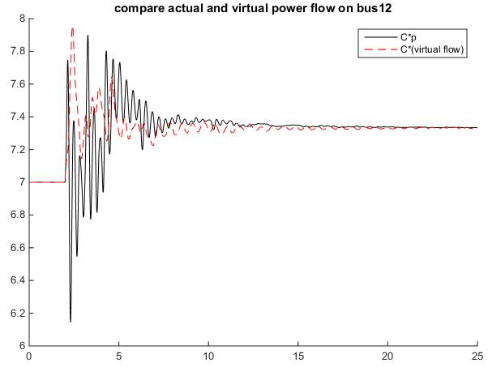
OLC for secondary control
demand = supply
restore nominal freq
key idea: “virtual flows”
in steady state:
virtual flow = real flows

Slide 96
OLC for secondary control
demand = supply
restore nominal freq
restore inter-area flow
respect line limit
in steady state:
virtual flow = real flows

Slide 97
Recall: primary control
swing dynamics:
implicit
active
control
load control:

Slide 98
Control architecture
physical network
cyber network

Slide 99
Secondary frequency control
load control:
computation & communication:
primal var:
dual vars:

Slide 100
Secondary control works
Theorem
starting from any initial point, system
trajectory converges s. t.
is unique optimal of OLC
nominal frequency is restored
inter-area flows are restored
line limits are respected

Slide 101
Recap: key ideas
Design optimal load control (OLC) problem
Objective function, constraints
Derive control law as primal-dual algorithms
Lyapunov stability
Achieve original control goals in equilibrium
Distributed algorithms
primary control:
secondary control:

Slide 102
Recap: key ideas
Design optimal load control (OLC) problem
Objective function, constraints
Derive control law as primal-dual algorithms
Lyapunov stability
Achieve original control goals in equilibrium
Distributed algorithms
Virtual flows
Enforce desired properties on line flows
in steady state: virtual flow = real flows

Slide 103
Recap: control goals
Rebalance power
Resynchronize/stabilize frequency
Restore nominal frequency
Restore scheduled inter-area flows
Respect line limits
Yes
Yes
Zhao, et al TAC2014
Yes
Yes
Yes
Mallada, et al Allerton2014
Secondary control restores nominal
frequency but requires local communication

Slide 104
Outline
Load-side frequency control
Primary control
Secondary control
Interaction with generator-side control
Zhao and Low, CDC2014
Zhao, Mallada, Low, CISS 2015
Zhao, Mallada, Low, Bialek, PSCC 2016

Slide 105
Generator-side control
New model: nonlinear PF, with generator control
Recall model: linearized PF, no generator control

Slide 106
Generator-side control
New model: nonlinear PF, with generator control
generator bus: real power injection
load bus: controllable load

Slide 107
Generator-side control
New model: nonlinear PF, with generator control
generator buses:

Slide 108
Load-side control
physical network
cyber network

Slide 109
Load-side primary control works
Theorem
Every closed-loop equilibrium solves OLC and its dual
Suppose
Any closed-loop equilibrium is (locally) asymptotically stable provided

Slide 110
Conclusion
Forward-engineering design facilitates
explicit control goals
distributed algorithms
stability analysis
Load-side frequency regulation
primary & secondary control works
helps generator-side control

Slide 111
Key message
Large network of DERs
Real-time optimization at scale
Computational challenge: power flow solution
Online optimization
Network computes power flow solutions in real time at scale for free
Exploit it for our optimization/control
Naturally adapts to evolving network conditions
Examples
Slow timescale: OPF
Fast timescale: frequency control

Slide 112
Online optimal power flow
Large network of DERs
Need real-time optimization at scale
Computational challenge: power flow solution
Online optimization
Network computes power flow solutions in real time at scale for free
Exploit it for our optimization/control
Naturally adapts to evolving network conditions
generic OPF problem
control x(t)
measurement y(t)

Slide 113
Application: EV charging
Online optimization of electric vehicle charging
Enables mass deployment at much lower infrastructure costs
First pilot @Caltech: 54 adaptive programmable chargers
2x 150kVA transformers, breakers, grid sensors, etc
Energized
Feb 13 Sat
2016
debugging
charger
150kVA transformer
main panel
1st customer

